Slide 1
Video 2
Last Video: Customer Lifetime Value
Point-Of-Sale (packages, 1-click upsells, order bumps, bonuses, etc.)
The Challenge … did you do it?!
Interest Driven Sales Funnel
Main Series (“House List”)
Structure
Tips, Tricks, Strategies
How to advertise your products and services on someone else’s site!

Slide 2
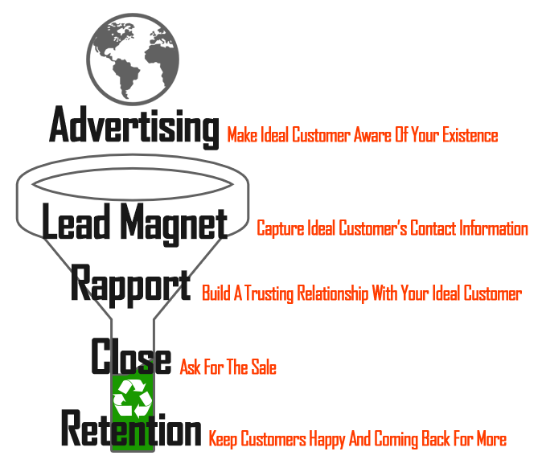
Video 2
Convert More Leads Into Paying Customers!
How?
Relevance

Slide 3
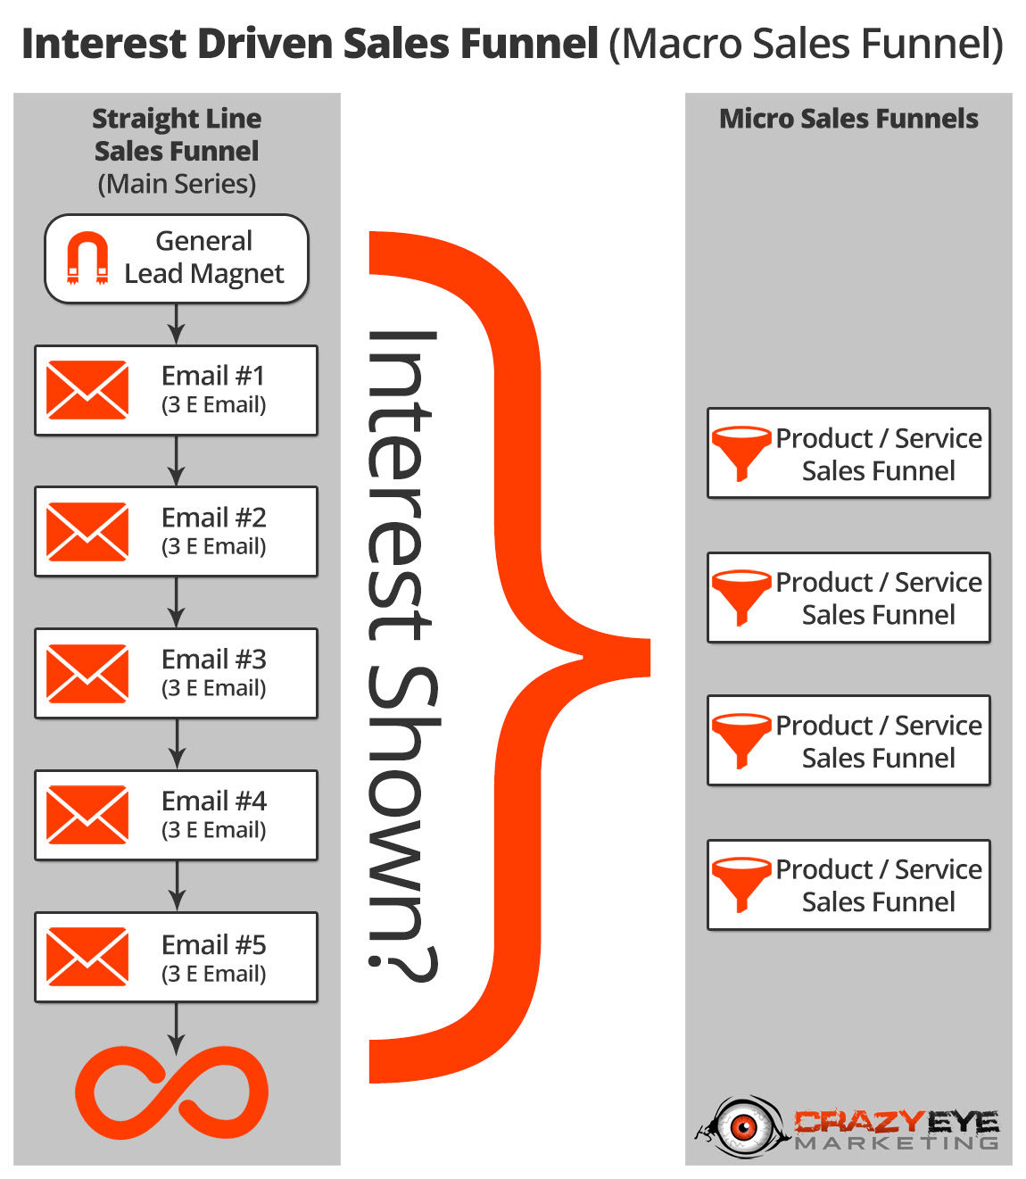
Interest Driven Sales Funnel
Main Series (“House List”)
Interest Shown?
Clicks
Page Views
Opt-ins
Purchases
Survey
Points
Product/Service Sales Funnel

Slide 4
Interest Driven Sales Funnel
Weekly “Pushes”
“Push” a particular product or service all week
Goal: Drive Subscriber To Sales Page
Don’t be sneaky about it!
Gauge interest (relevance! Product/Service SFs)
Send 4-5 emails:
Email 1: Story
Email 2: Sales
Email 3: Content
Email 4: Content
Email 5: Content

Slide 5
Interest Driven Sales Funnel
Email 1: Story (direct link to sales page)
“Related” Story
Testimonial-ish / Hero’s Journey
Personal Story
“Indirect” Story
That time I tried something new and had an amazing time! (great results)
Email 2: Sales (direct link to sales page)
Marketing / Copywriting Formula
Features-Advantages-Benefits, Problem-Agitate-Solve, Before-After-Bridge
Link below

Slide 6
Interest Driven Sales Funnel
Emails 3-5: Content (blog post, video, other resource/site – each of these link to sales page. Link to sales page in PS.)
How to advertise your products and services on someone else’s site!
https://www.appocalypsis.com/
http://snip.ly/
http://startafire.com/

Slide 7
To Do
Take Your Top Selling Product/Service
Write 4-5 Subject Lines & Brief Synopsis
Story
Sales
Content x 2/3

Slide 8
Next Video
Product/Service Sales Funnel
Fill-In-The-Blank Template!

